Slide 1
EXCEL PROJECT
BY HOWARD BERRY

Slide 2
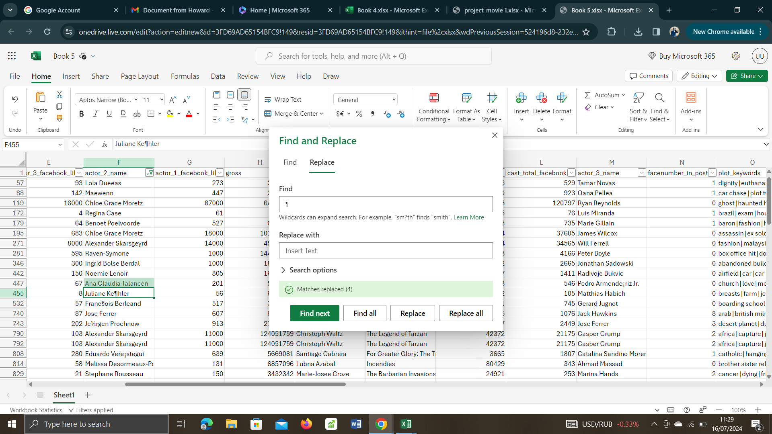
The process of data cleaning is criticalal I every data t0 be analysed. Below is a slide of how I cleaned the data I was analyzing

Slide 3
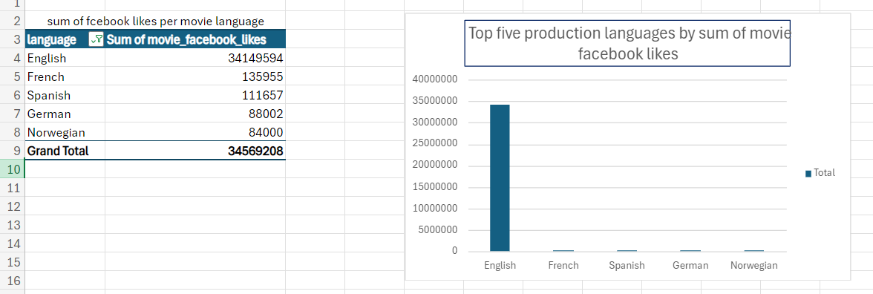
The Two sets of data are used to show the top languages viewed by audience based on their facebook likes.

Slide 4
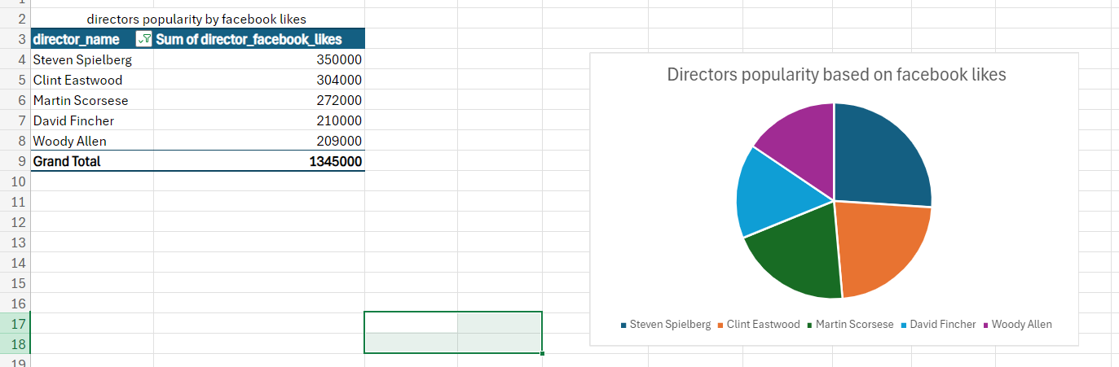
The data sets below shows the top five directors and their influence on movies based on sum of their facebook likes

Slide 5
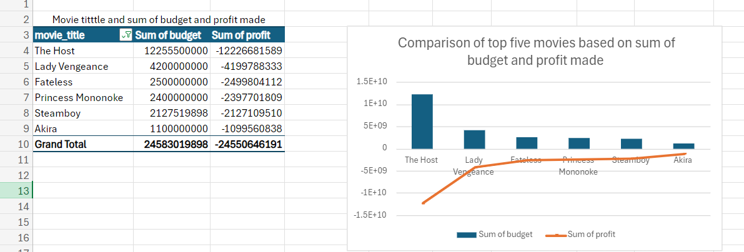
The data set below shows the top movies in production, their budget and profit ade by the production lines from the movies

Slide 6
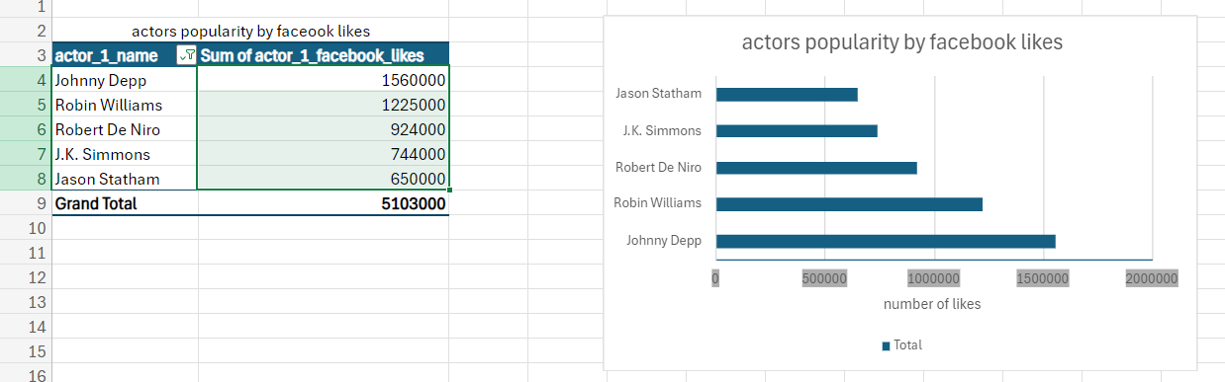
The data sets below is used to show actors influence on movies and production based on sum of the actrs facebook likes

Slide 7
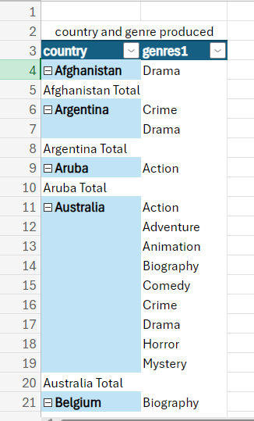
The data set shows the genre produced by different countries and can help production lines know where most genres are being produced

Slide 8
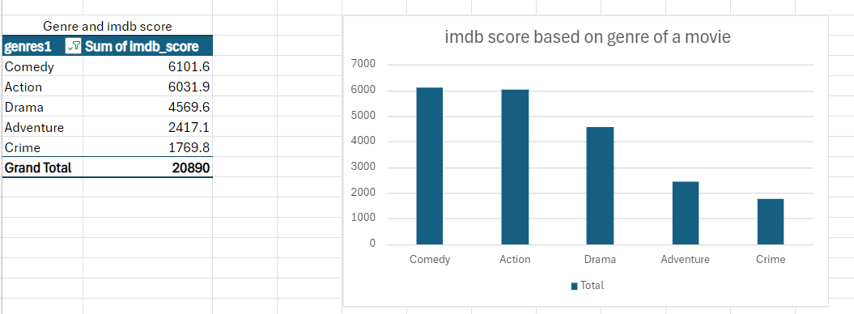
The setups below are used to show which genre has the largest imdb scores. These are the top five genres with high imdb scores in descending order.

Slide 9
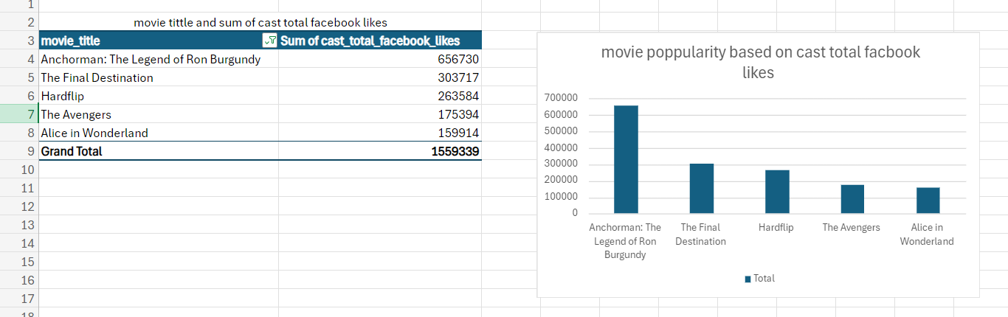
The data sets below is used to show the influence of cast in movies based on sum of cast total facebook likes

Slide 10
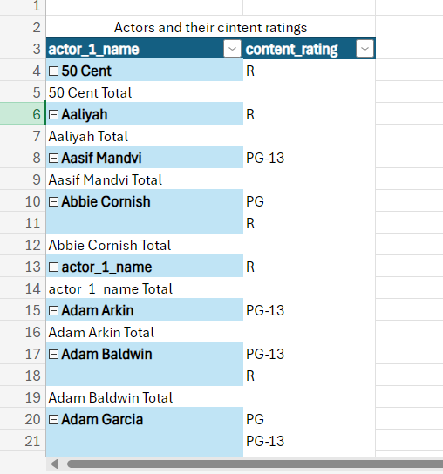
The data set below show the ratings of different actors. This helps producers to pick their casts based on the movie they are working on

Slide 11
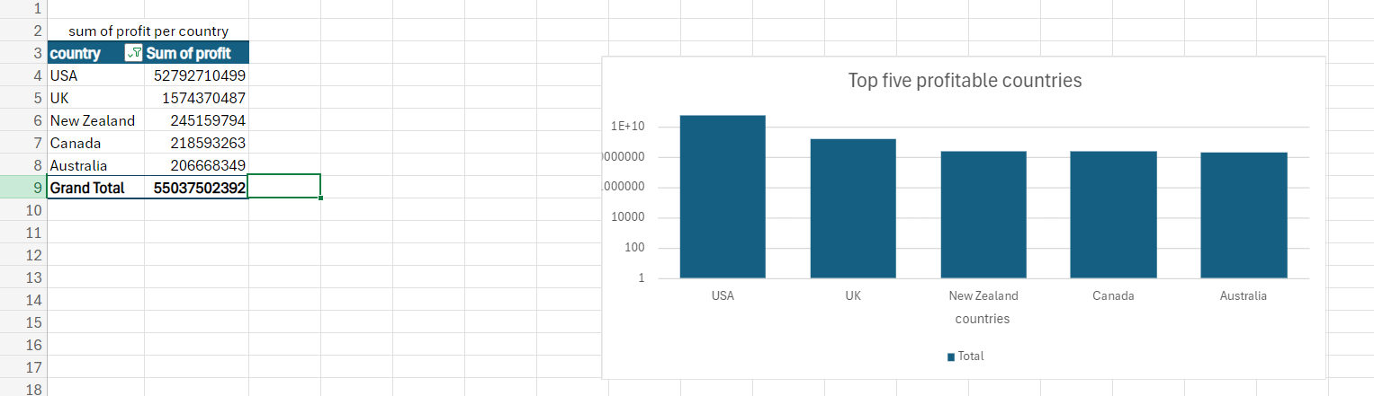
The data sets below shows the top five profitable countries based on sum of profit per country

